Slide 1
Car Following Senior Project Sprint 1
Josh Baird, Evan Haskell, Justin Kur, Cody Trombley, Charlie Wingate

Slide 2
The Big Picture
Our group is continuing an earlier effort from another project team in the development of an automated leader/follower vehicle system.
The system is composed of the following:
A desktop application to allow pilots to operate the vehicles
Two or more camera equipped programmable smart vehicles
The goal of our project is to ultimately increase the functionality, improve the performance, and increase the ease of use of the leader/follower vehicle system.

Slide 3
User Stories
As a vehicle pilot, I need to be able to control the directional input of a designated leader car.
As a following vehicle, I need to quickly and accurately determine the direction and speed the leader is navigating and move in the appropriate direction.
As a following vehicle, I need to determine when I have lost sight of my target and take corrective action to reestablish line of sight.
As a following vehicle, I want to be able to detect and navigate around obstacles between myself and the leader.
As a vehicle pilot, I want to be able to switch which vehicle is the leader on the fly.
As a vehicle operator, I want to be able to send precreated input data to the lead car.

Slide 4
Project Requirements
R1. The system shall support at least two cars: one to lead and one to follow.
R2. The system shall allow any one registered vehicle to function as the lead vehicle.
R3. The system shall allow any registered vehicle to function as a following vehicle.
R4. The system shall allow the user to transmit directional movement instructions to the vehicle in leader mode.
R5. A following vehicle shall avoid collisions with the leader vehicle.
R6. A following vehicle shall maintain a safe distance from the leading vehicle.
R7. A following vehicle shall stay within a reasonable configurable distance from the leading vehicle.
R8. A following vehicle shall avoid collisions with foreign obstacles.
R9. A following vehicle that loses visual contact with a leader should attempt to reestablish following protocol.
R10. The system shall allow the user to enable logging and saving image data received on the remote client from the following vehicle.
Notes:
Requirements highlighted in yellow will be our areas of focus

Slide 5
Project Requirements (continued)
R11. The system shall allow a mirroring mode, wherein the following vehicle mirrors the instructions given to the leading vehicle on a delay. R12. The server application shall be able to log all movement inputs from a driving session. R13. The leader car shall be able to read and execute input data from a saved file. R14. The system shall be able switch leader and follower vehicles during program execution. R15. The system shall be secure to external threats. R16. The application shall have zero severity level one defects. R17. The application shall support a remote control range of 20 meters. R18. The application shall have a mean time between failures of 30 days. R19. The system shall allow one user to control the leader vehicle at a time. R20. User input will have a response time of at most 250 milliseconds.

Slide 6
Project Plan by Sprint
Sprint 1
Acquire vehicles and confirm working status and begin becoming familiar with existing codebase.
Sprint 2
Allow controller machine to record image data it’s sent; Collect driving training data; Begin labeling data for supervised learning
Sprint 3
Continue collecting and labeling training data; Train and test mirrored inputs machine learning model; Develop camera control module.

Slide 7
Project Plan by Sprint (continued)
Sprint 4
Enable vehicles to share data and incorporate into model; Adjust model hyperparameters
Sprint 5
Explore object avoidance protocols; Implement switching leader and follower during execution
Sprint 6
Train and test machine learning model with object detection
Sprint 7 & 8
Testing, Bug fixes, and Code Optimizations

Slide 8
Next Sprint Objectives
Allow controller machine to record image data it’s sent
The system already receives image frames, but they must be saved and organized
Collect driving training data
Test drives must be performed so that examples of proper following behavior can be saved
Begin labeling data for supervised learning
This will be the foundation of our machine learning driving system

Slide 9
Challenges
Difficulty logging into SSH
Difficulty with the .NET application
Cannot effectively pilot via keyboard
Controller needed
Configuration of the vehicle is slightly inaccurate (alignment of wheels)

Slide 10
Risks and Mitigations
Machine Learning
We plan to use machine learning to train an AI on how to properly respond to the leader car’s movements.
If the computer vision turns out to not function adequately, we can still improve the existing tag based following mechanism.
Object Detection for Obstacle Avoidance
We may train the model to detect objects which could be considered obstacles.
This model may or may not prove to be viable.

Slide 11
Technology and Tools
2 PiCar-Vs from SunFounder
Git, GitHub, GitHub Project Boards, Discord, Google Docs
Bash scripts for installation of dependencies and updating our project on the Pis
.NET for client application that controls leader (inherited from previous group)
A gamepad for controlling the leader
Python for vehicle navigation code
OpenCV computer vision library
Pytorch and fastai libraries for ML

Slide 12
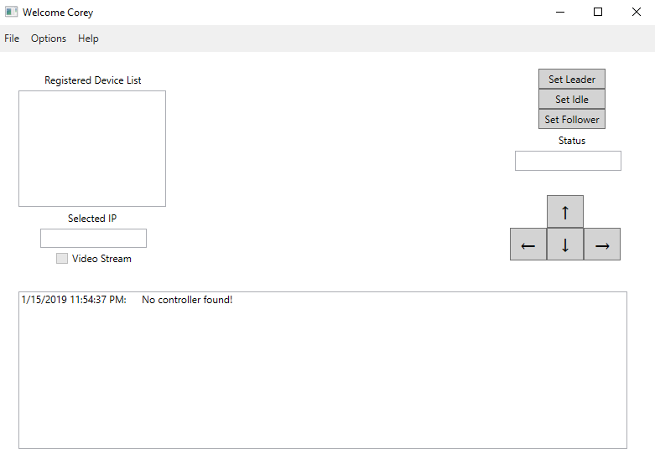

Slide 13
